Slide 1



ฟินชัวร์
Stay Protected, Pay Smarter -
Dynamic Pricing for Everyday Risks
More Details

Slide 2
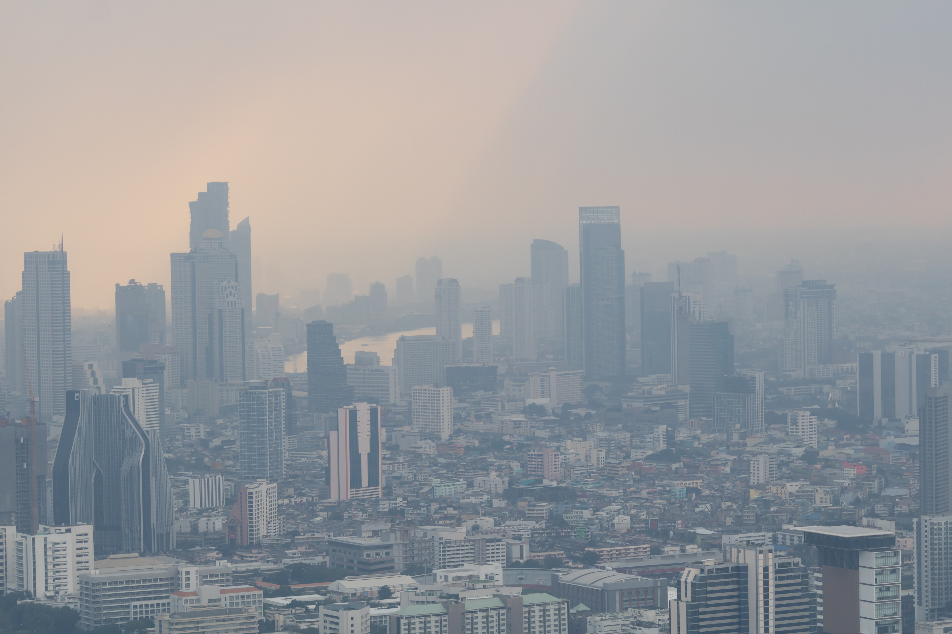
Project
Overview
Thailand’s blue-collar workers—construction crews, delivery riders, factory staff—face income loss every winter as PM2.5 smog forces job shutdowns. While necessary for health, these disruptions leave millions without support.
PM2.5 Income Shield offers microinsurance that activates during pollution-related work stoppages, providing fast, flexible income replacement via mobile wallets.
Using real-time air quality data, location-based risk detection, and AI-driven policy management, we deliver timely protection for vulnerable workers.

Slide 3
Problem
Economic Disruption
Income Loss
Financial Resilience
PM2.5 pollution leads to government-imposed work halts (e.g., construction bans, remote work), slowing down urban economic activity.
Daily wage workers—especially in construction and other labor-intensive sectors—are left without income or support during pollution-related shutdowns.
There is currently no protective mechanism in place. Microinsurance can fill this gap by offering income protection when air quality exceeds safe levels.

Slide 4
Solution
Microinsurance that provides income protection for daily wage workers during PM2.5-related work stoppages.
Dynamic Pricing
Automatic Payouts
Easy Access
AI-driven pricing based on risk and pollution levels.
Triggered by PM2.5 thresholds.
Mobile platforms and local representatives.

Slide 5
Market Validation
PM2.5 pollution causes daily wage workers to lose income due to government-mandated outdoor work suspensions.
State welfare card in Thailand
Market Readiness
13.07
Climate-induced pollution is recurring and intensifying, creating a growing demand for income-linked microinsurance.
million
Notes:
ความเป็นไปได้ของตลาด

Slide 6
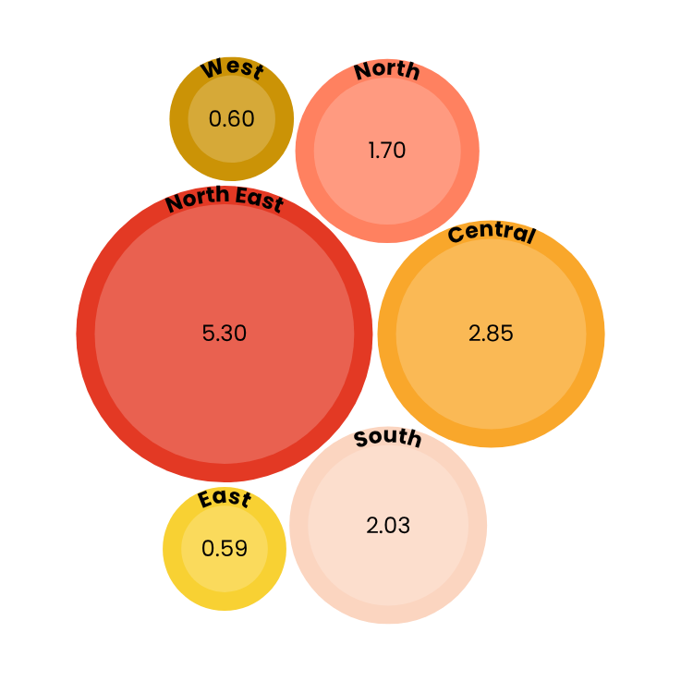
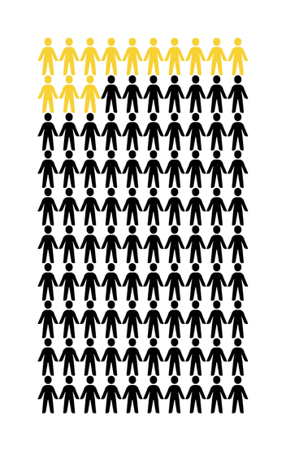
Market Size
13.07 M
BKK : 368,069
Other : 2.48 M
State welfare card in Thailand
Total Available Market : Apr 2025
source : https://govwelfare.cgd.go.th/welfare/reportSubprov

Slide 7












Finsure Service Route
Registration Process
AI-Based Pre-Screening and Dynamic Pricing Data Analysis.
Customer
Village Agent or community leaders using the app
Register/Login
Insurance Contract Approval & Payment Selection
Claim Process
Triggering Events
Customer
Submit Claims
Claim Disbursement
Required Supporting
Documents
Medical Treatment Documents
Insurance Premium Provided by the Insurance Company
Area-Specific Air Quality Index (API/PM2.5)
Income Compensation Documents

Slide 8


🧾 Dynamic Pricing – PM2.5-based rates
🌤️ Live AQI Sync – Real-time air updates
📲 Easy Claims – Claim via app
🛡️ Low-Cost Plans – For everyone
Health Insurance with Dynamic Pricing
Get Started
→
Download on the
Your Store

Slide 9
MOCK UP
Insurance Coverage & Benefits & Dynamic Pricing
BASIC
STANDARD
ADVANCED
PREMIUM
190 THB
390 THB
590 THB
990 THB
Income Compensation : 150 THB/day
Medical Expense Coverage: 500 THB/visit
Death Benefit : 1,450 THB
Income Compensation : 200 THB/day
Medical Expense Coverage: 1,000 THB/visit
Death Benefit : 3,600 THB
Income Compensation : 300 THB/day
Medical Expense Coverage: 1,500 THB/visit
Death Benefit : 5,400 THB
Income Compensation : 500 THB/day
Medical Expense Coverage: 2,000THB/visit
Death Benefit : 16,500 THB
Key Pricing Factors:
Forecasted AQI (maximum adjustment +7%)
High-Pollution Months (maximum adjustment +5%)
Demand Surge Sensitivity (maximum adjustment +5%)
The FinSure policy provides coverage exclusively for illnesses medically associated with PM2.5 air pollution
Acute Bronchitis and Acute Bronchiolitis
Chronic Bronchitis, Emphysema, and Other Chronic Obstructive Pulmonary Diseases (COPD)
Malignant Neoplasms of the Trachea, Bronchus, and Lung
Acute Myocardial Infarction (Heart Attack)
The policy covers actual medical expenses incurred, up to the maximum insured amount.
**Note: This condition is subject to a 30-day waiting period from the date of policy issuance.

Slide 10
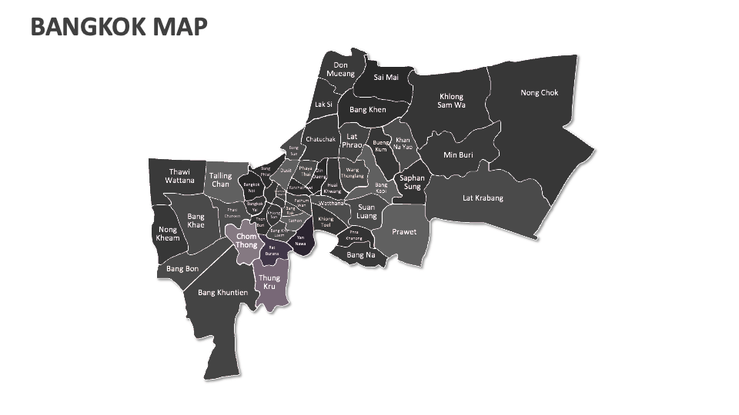


MOCK UP
Insurance Coverage & Benefits & Dynamic Pricing
BASIC
STANDARD
190 THB
390 THB
Income Compensation : 150 THB/day
Medical Expense Coverage: 500 THB/visit
Death Benefit : 1,450 THB
Income Compensation : 200 THB/day
Medical Expense Coverage: 1,000 THB/visit
Death Benefit : 3,600 THB
ADVANCED
PREMIUM
590 THB
990 THB
Forecasted AQI = 180 → +5%
High season (Dec) → +1%
High demand → +1%
Adjusted Premium
=390 THB × (1 + 0.05 + 0.01 + 0.01)
= 417.3 THB
Income Compensation : 300 THB/day
Medical Expense Coverage: 1,500 THB/visit
Death Benefit : 5,400 THB
Income Compensation : 500 THB/day
Medical Expense Coverage: 2,000 THB/visit
Death Benefit : 16,500 THB
Forecasted AQI = 195 → +5%
High season (Jan) → +4%
High demand → +3%
Adjusted Premium
=390 THB × (1 + 0.05 + 0.04 + 0.03)
= 436.8 THB

Slide 11





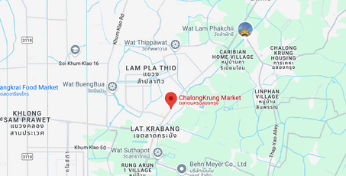





Create New Account
FINSURE
FINSURE
Already Registered? Log in here.
Summary
Claims
NAME
Jiara Martins
Dynamic Pricing
EMAIL
Standard
hello@reallygreatsite.com
Bangkok
PASSWORD
*****
CONFIRM
APPLY NOW
388
THB
Register
AI Advisory
Apply Now
Claims

Slide 12


Competition
Direct
Competitors
Government welfare programs
Informal lending options
NGOs and charitable aid
Traditional insurers: e.g., Thai Life, Muang Thai Life, Dhipaya
Digital microinsurance platforms: e.g., Roojai, Sunday
Indirect
Competitors

Slide 13
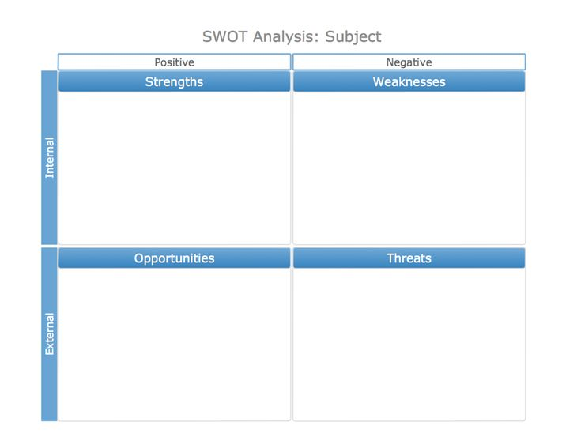
SWOT Analysis
Real-time AQI + AI for dynamic, fair pricing
Designed specifically for daily wage earners
Community-based onboarding via Aor Sor Mor
Linked to state welfare cards for easy payments
Multi-insurer partnerships for flexible, low-cost plans
Low insurance literacy in target groups
Dependence on external data (e.g., AQI, state systems)
Scaling difficult in areas without Aor Sor Mor
PM2.5 is a seasonal, ongoing crisis
Policy momentum toward inclusive social protection
Expandable to other climate-related risks
Fintech tools enable scale and efficiency
Policy inconsistency on work suspension orders
Potential competition from larger insurers
Misunderstanding of payout conditions
Data privacy and legal compliance risks
Low tech skills among rural or older users

Slide 14
Competitive Advantages
AI-powered risk scoring & dynamic premiums
Trusted local distribution
for fairness
via Aor Sor Mor agents
Integrated with government systems
Multi-insurer collaboration
(e.g., welfare card disbursement)
on a single centralized platform

Slide 15
Goals
Vision
Mission
Goals
Create Thailand's leading Microinsurance platform protecting vulnerable low-income workers against PM2.5 pollution risks
Develop accessible and affordable digital income protection solutions for daily wage workers
Deliver accessible and affordable coverage through dynamic pricing and community networks

Slide 16
Adoption Strategy
FinSure’s strategy is built around one core principle: accessibility at scale to drive volume, growth, and efficiency
Strategic Objective
Maximise customer reach through radical accessibility
Use personalised pricing to match real customer capacity
Scale cost-effective distribution through local networks
Simplify onboarding to convert awareness into action
Build insurer confidence through volume and data
Lay groundwork for public-private collaboration

Slide 17
Business Model
Revenue from insurance premiums (10% platform share) and advertising
Distributed via village health volunteers (Aor Sor Mor) to reduce customer acquisition cost
Public-private partnerships with insurers, government agencies, and NGOs
Scalable through mobile and community-based channels

Slide 18
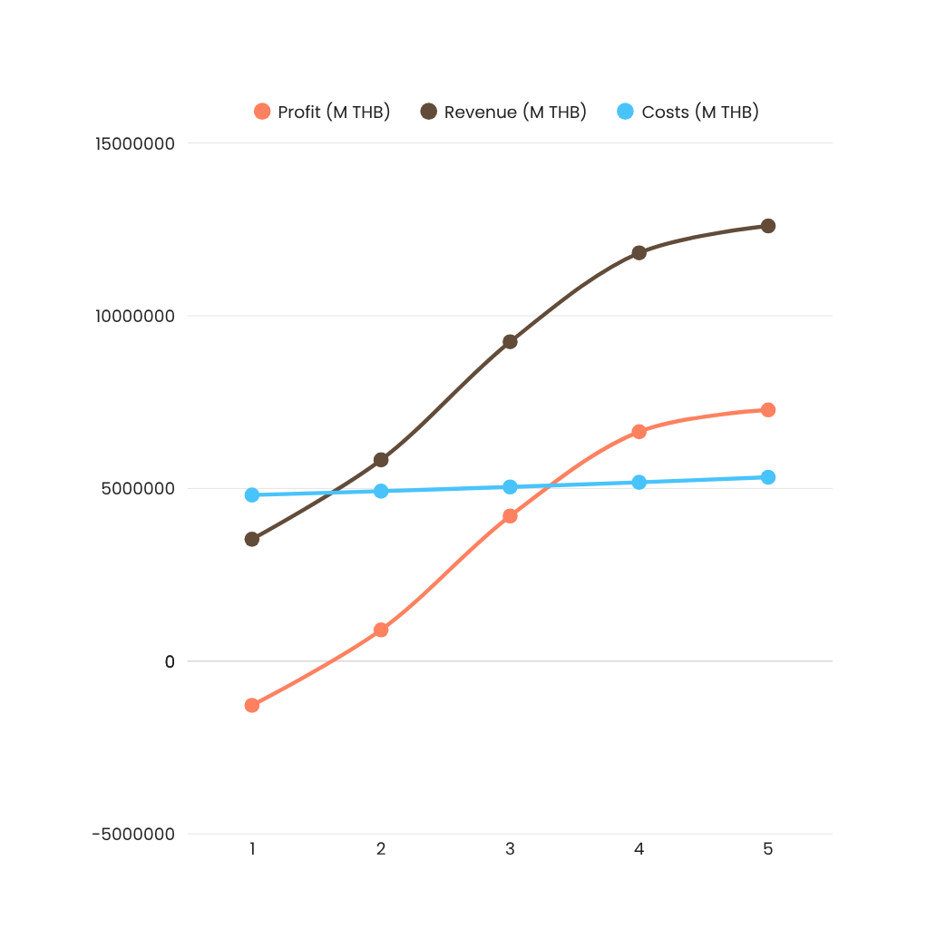
Financial
12.6 M
(THB)
3.7 M
(THB)
Total Investment
Total Revenue 5Y
136.6 %
ROI
3Y
Break-even
Revenue Streams:
Insurance premiums (growing annually)
Advertising partnerships (2–4 corporate sponsors by Year 3+)
source : https://www.milliman.com/en/insight/health/microinsurance-a-new-insurance-model-for-the-developing-world/

Slide 19



Success Metrics
Government Welfare’s Success Rate
Claim
Processing Time:
Customer
Satisfaction Rate:
≥ 70%
≤ 48
≥ 65%
hours

Slide 20
Pilot (Months 1–2)
Conclusion and Next Steps
Beta test in Bangkok, train community agents.
Soft Launch (Months 3–4)
Targeted rollout & digital campaigns.
Full Launch (Months 5–6)
Expand to 3–5 provinces, deploy insurer dashboards.
PM2.5 Income Shield addresses a critical gap. It provides financial protection for laborers affected by air pollution. Leveraging AI, community-based distribution, and dynamic pricing. Aims to create accessible, affordable, and effective insurance.
Scale (Months 7–12)
Add flexible plans, loyalty program, employer group sales.
Long-Term Sustainability
Explore regional expansion & long-term public-private integration.

Slide 21
Thank
You

